Slide 1



Capstone Project Phase 1
Parkinson's Perspective: Visualizing Impact
Students:
Omer Fatal
Tanya Gendelman
Supervisors:
Dr. Julia Sheidin
Dr. Avital Shulner
Project Code: 25-1-D-6

Slide 2
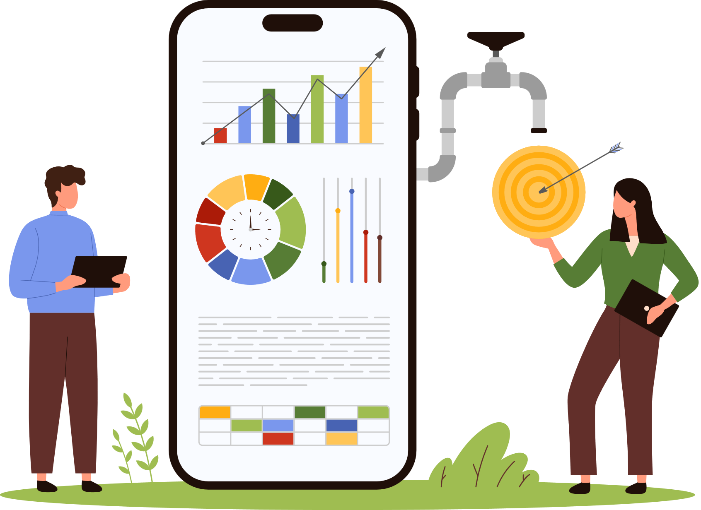
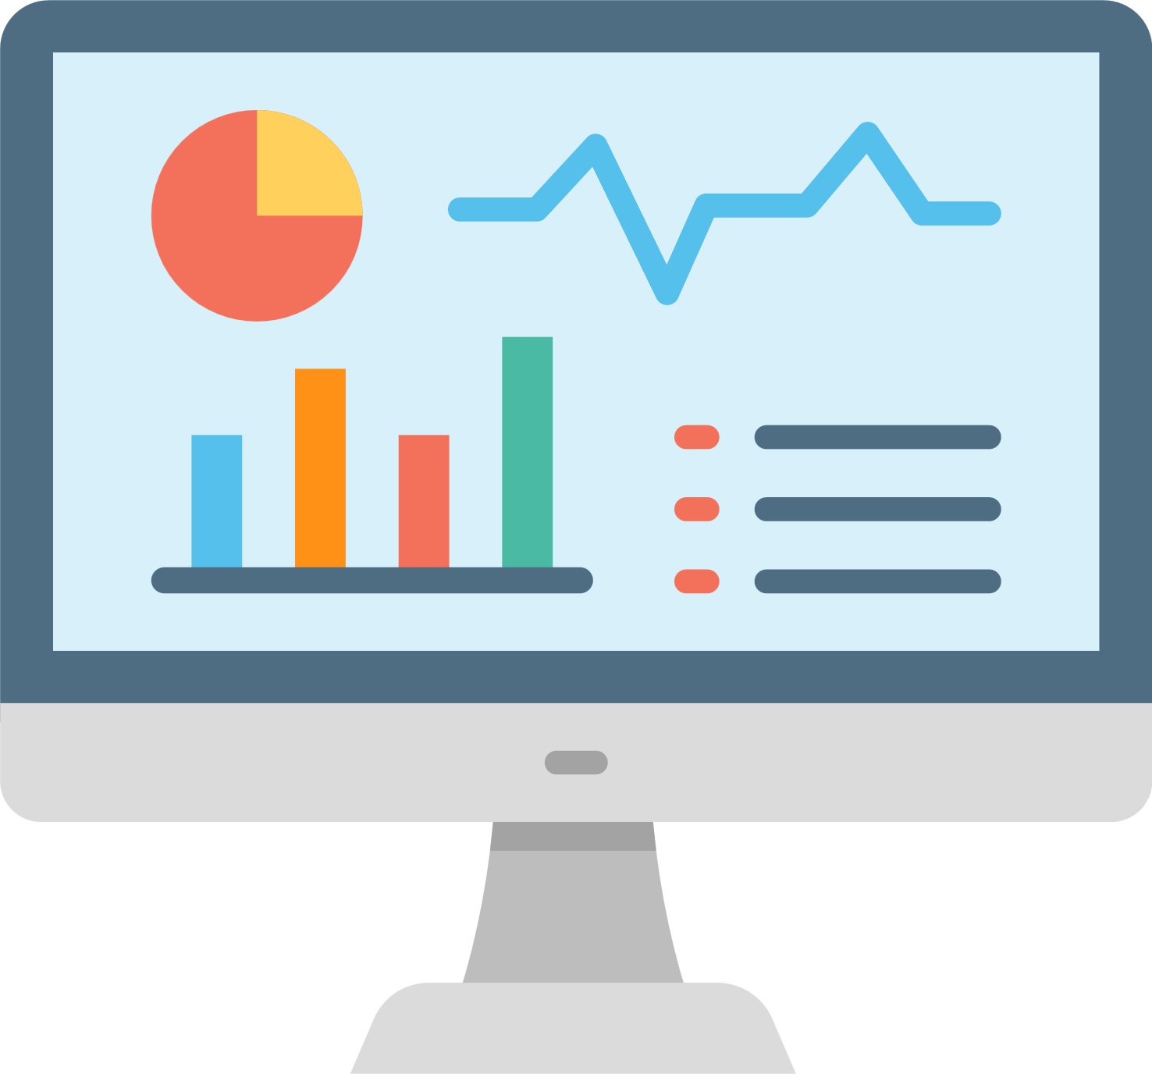
Introduction
Parkinson’s disease is a progressive neurological condition that causes tremors, stiffness, and slowed movement.
Effectively managing Parkinson’s requires tracking routines and symptoms, but current tools often lack clarity and fail to provide personalized, actionable insights.
Our project addresses this problem creating clear, interactive visualizations,such as heatmaps and graphs that empower patients to track progress, identify patterns, and optimize their daily routines.
This work builds on the efforts of the previous project, which focused on collecting data from Parkinson’s patients.

Slide 3

Impact on Parkinson’s Disease Patients
PD significantly impacts patients' daily lives, both physically and emotionally.
Motor symptoms like tremors, stiffness, and slowness make everyday tasks, such as walking or eating, more challenging.
Non-motor symptoms, such as anxiety, depression, and trouble sleeping, lower the overall quality of life.
The progressive nature of the disease often leads to a loss of independence, increased reliance on caregivers, and feelings of social isolation.

Slide 4

Importance of Explanations in PD Management
Many Parkinson’s patients struggle to link daily choices to symptoms. The lack of personalized insights makes care decisions more challenging.
Textual and visual explanations address different patient needs effectively:
Textual explanations simplify information, easing anxiety and boosting confidence.
Visual explanations such graphs reveal patterns, helping patients understand trends.
These tools help patients improve routines for better management.

Slide 5

Existing Solutions
We reviewed and analyzed various tools for Parkinson’s data visualization such as “DataPark”, “PD-Insighter”, and dashboards.
DataPark: Shows energy, activity, and sleep trends but lacks personalized insights.
Dashboards: Tracks medication and symptoms but primarily targets clinicians.
PD-Insighter: Analyzes motor patterns but focuses on clinicians, not patients.
While these tools provide valuable insights into Parkinson's management, they lack a patient-centered approach, focusing more on clinical needs than empowering individuals to manage their daily lives.

Slide 6

Expected Achievements
The goal of this project is to empower Parkinson's patients by providing a platform to visualize and understand how their daily activities impact their symptoms.
Develop a web-based dashboard for tracking routines.
Transform raw data into clear, interactive visualizations.
Ensure the platform is mobile and desktop accessible.
Design an intuitive and user-friendly interface.
Encourage patient engagement and routine improvement.

Slide 7

Engineering Process
Our process included:
Reviewing Michael’s Excel file, taken from the project book of the previous project, which documented daily activities over several months, including sleep patterns, physical activities, food intake, and medication schedules.
Analyzing existing resources and conducting a literature review to guide the visualization design.
Exploring various data visualization tools to identify intuitive and accessible methods for presenting the data.
Categorizing the data into six key groups: Physical Activity, Nutrition, Rest and Sleep, Medication, Symptoms, and Feeling Scores.

Slide 8

Our Solution
Our solution will be a fully responsive web-based system accessible on both mobile and desktop devices, ensuring seamless use across platforms.
It will feature a user-friendly interface designed for intuitive navigation and interaction.
Interactive visualizations like heatmaps and graphs will help patients track progress, identify patterns, and optimize their daily routines.

Slide 9
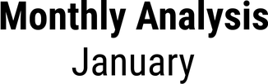
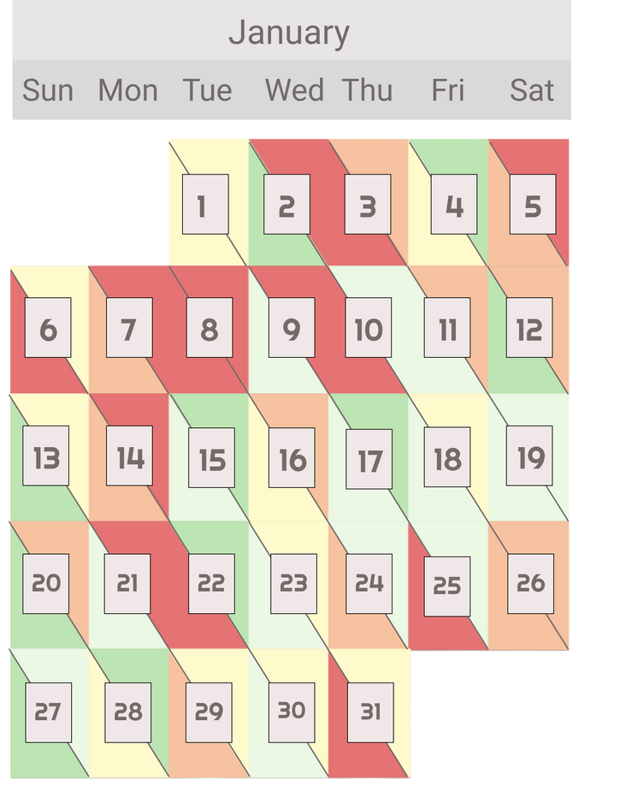

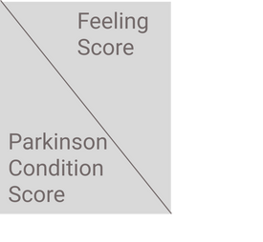
Prototype Screens
Monthly Analysis Screen: This is the main screen that contains the "Monthly Feeling and Parkinson Score Overview".

Slide 10
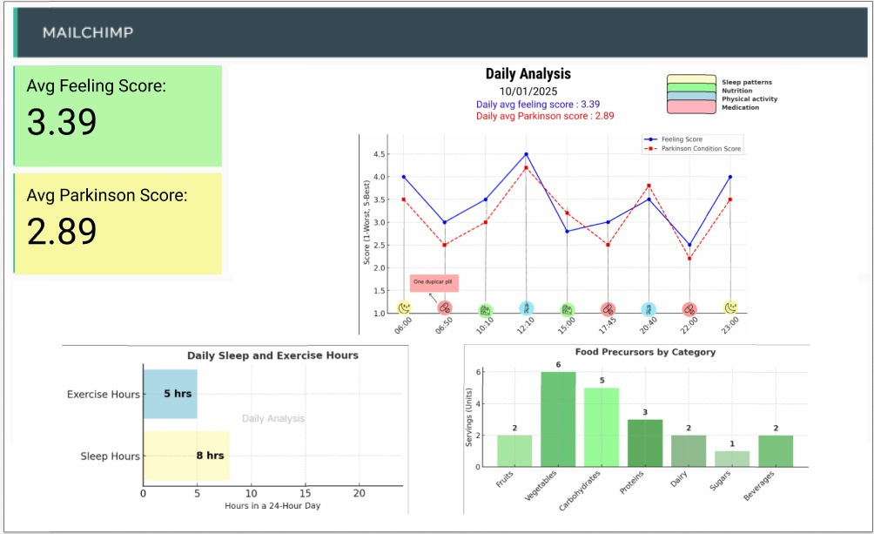
Prototype Screens
Dashboard Screen: This screen provides detailed visualizations and textual explanations for the chosen day.

Slide 11
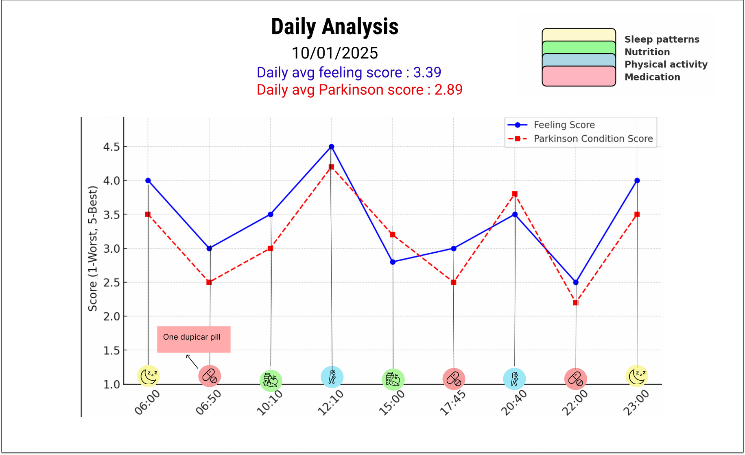
Prototype Screens
Daily Analysis Graph: This line graph maps activities alongside their corresponding Feeling Scores and Parkinson's Condition Scores throughout the day.

Slide 12
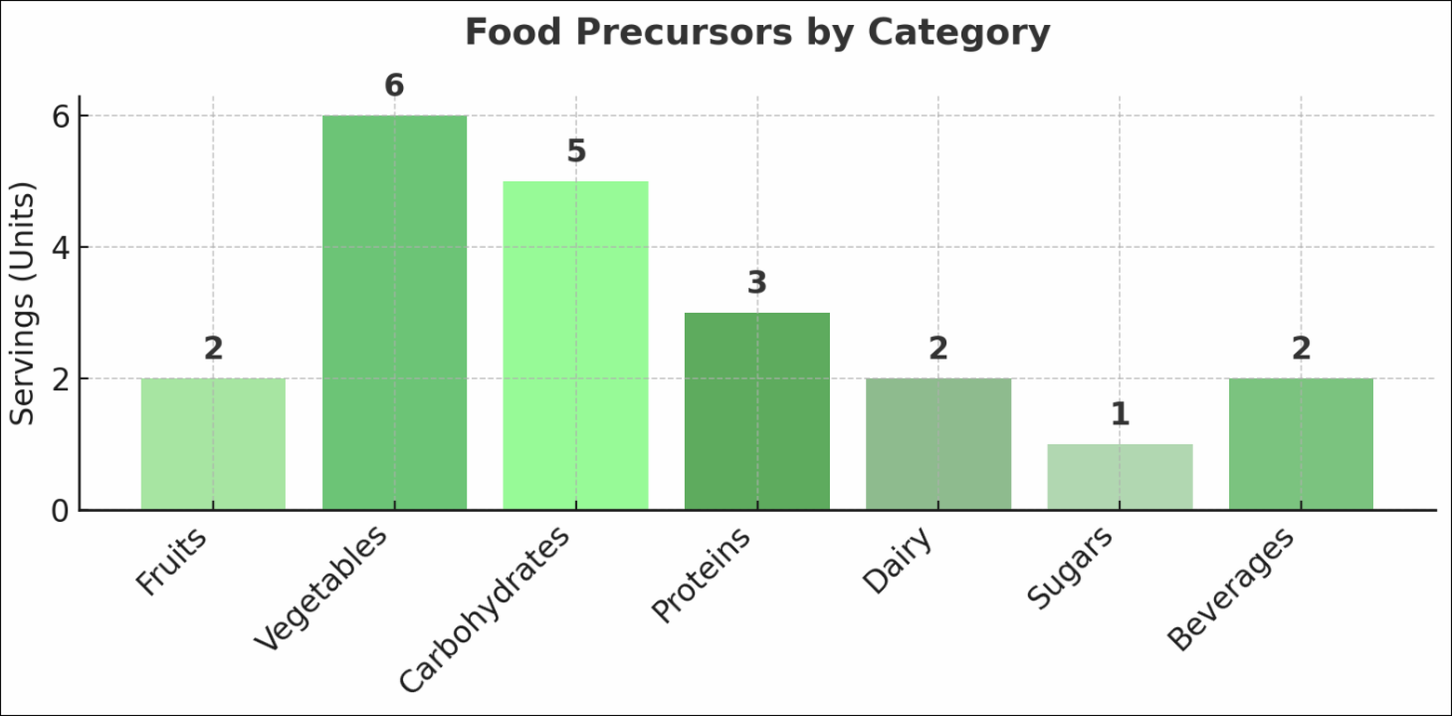
Prototype Screens
Food Precursors chart:This bar chart summarizes the servings consumed from various food categories throughout the da

Slide 13
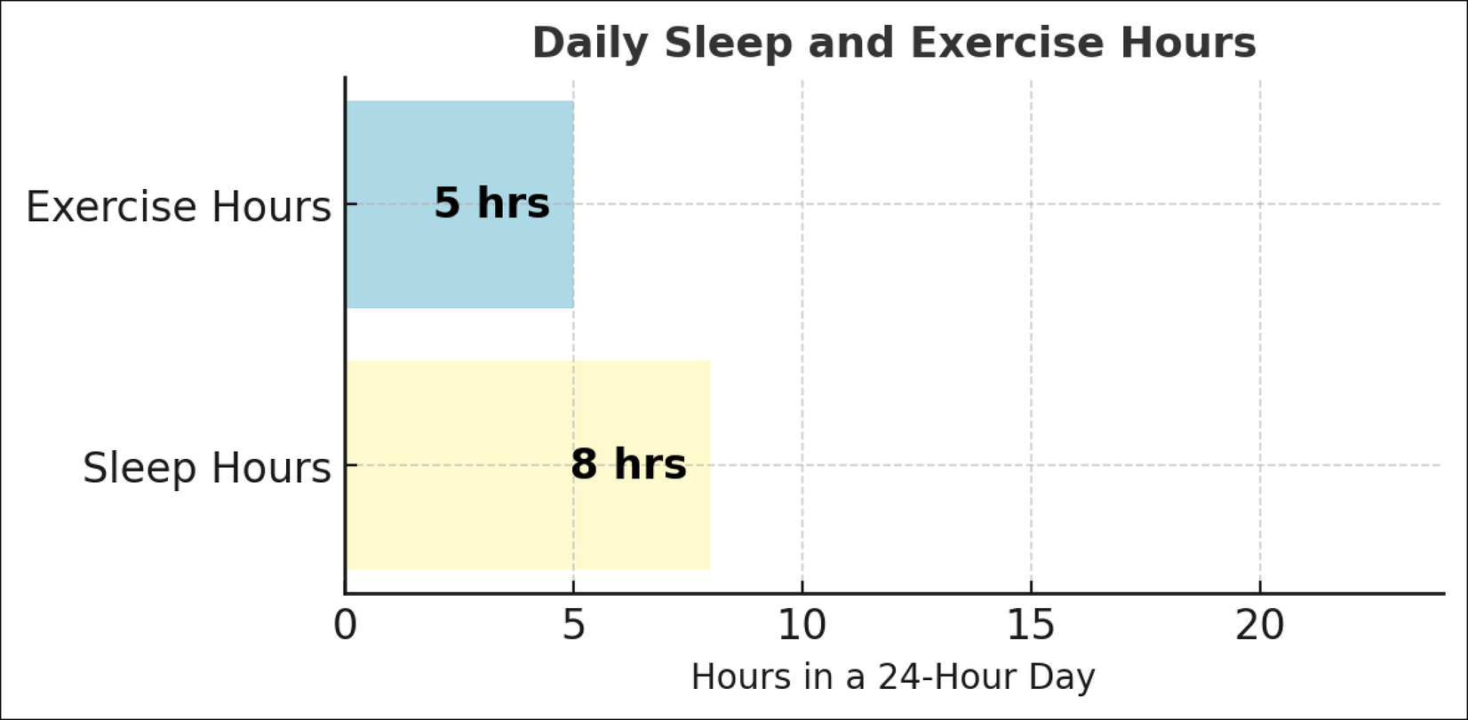
Prototype Screens
Daily Sleep and Exercise Hours graph: This bar chart shows the daily distribution of hours spent on sleep and exercise

Slide 14
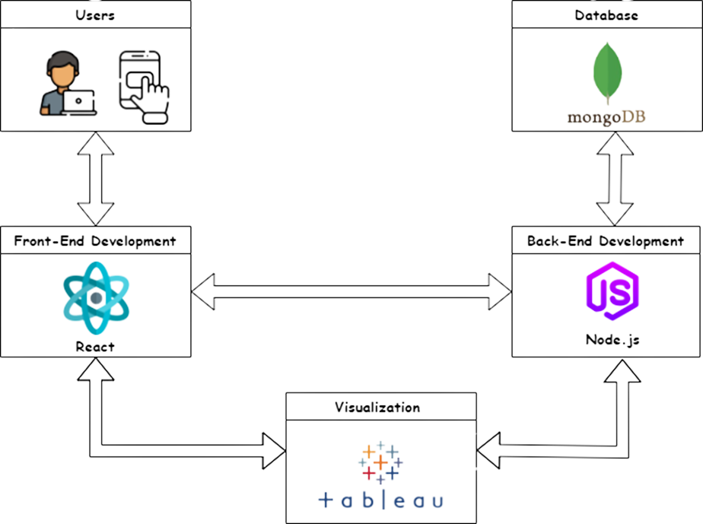
System Architecture
The system will include React for the frontend, Node.js for the backend, MongoDB as the database, and Tableau for visualization.

Slide 15

Expected Challenges
The main challenge we anticipate is establishing a connection to the data collected in the previous phase, which is critical for creating meaningful visualizations.
We have identified three options to address this challenge:
Integrate with the database used by the previous project team.
Create an independent system with a custom database and upload feature.
Use Michael’s Excel file, requiring preprocessing to organize the data.

Slide 16
Evaluation / Verification Plan
# | Test Subject | Test Headline | Expected Results
1 | Data Visualization | View Heatmap | The system displays an interactive heatmap showing daily and monthly scores clearly.
2 | Data Visualization | View Line Chart | The line chart shows fluctuations in feelings and conditions over a day.
3 | Data Visualization | View Bar Chart | The bar chart displays a breakdown of activity categories accurately.
4 | Dashboard Navigation | Navigate between visualizations on the dashboard | The transition between screens is intuitive.
5 | Multiple Visualization Views | Display multiple visualizations simultaneously | The dashboard renders multiple charts without performance issues.

Slide 17
Thank You
For your attention

